Slide 1
MY UNIQUE COUNTRY
SLOVENIAN FOOD
AUTHOR: Zarja Bašelj, 9.b

Slide 2
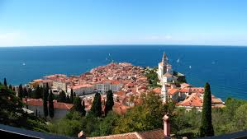
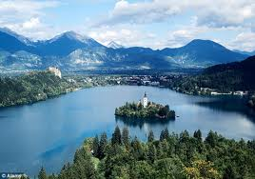
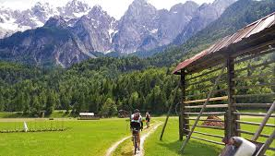
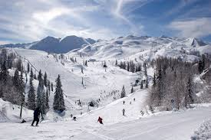
Slovenia is a small country but it can still charm you with unforgettable flavours that are the product of the traditional cuisine. This was created as a mixture of the influences of the Alpine, Pannonian and Mediterranean world, which is why you can find a variety of different specialties here. The world famous dishes are also protected with the designation of origin.

Slide 3
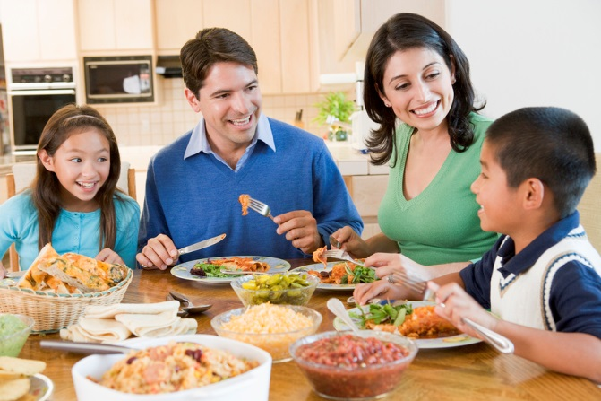
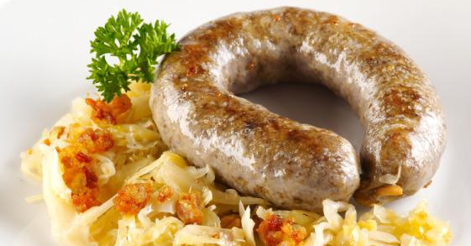
Eating habits
Most Slovenian eat 3 meals a day: breakfast, lunch and dinner. Lunch is the biggest and most important meal of the day.
Slovenian traditional cuisine is "heavy". Many dishes are hard to digest. It is based on the use of animal fat (cracklings, lard, bacon), pork, flour-based dishes, potatoes, beans, butter, cream and eggs
Breakfast and dinner are either warm or cold, but lunch is always warm.
The worst eating habit we have is leaving breakfast out because of the lack of time.

Slide 4
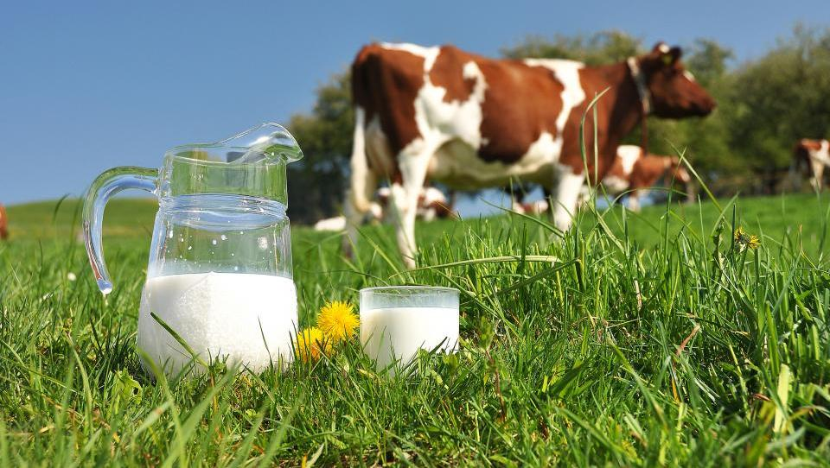
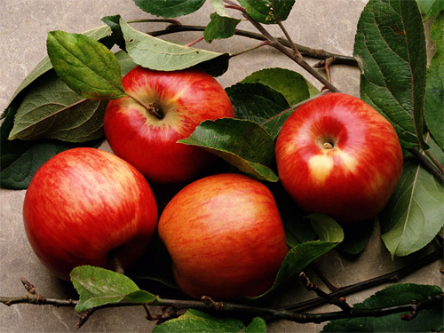
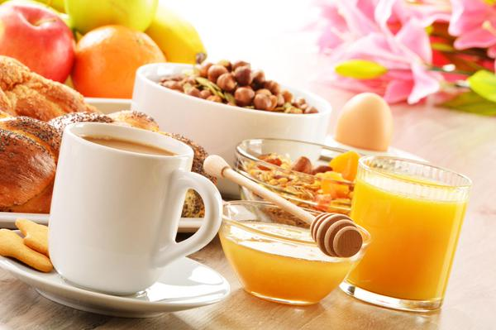
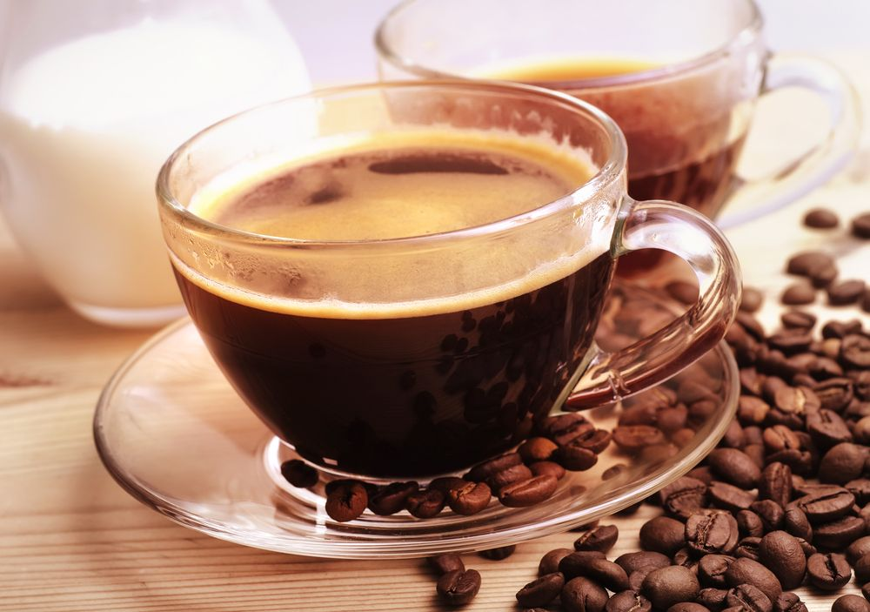
Traditional Slovenian Breakfast
Traditional breakfast is bread with butter and honey, apple and milk.
But for breakfast we also eat eggs, bread and salami, cheese, pate or jam, cereals…. We drink orange juice, cacao, milk, tea or coffee.
If we don‘t have time for breakfast we just drink some coffee and eat a piece of fruit.

Slide 5
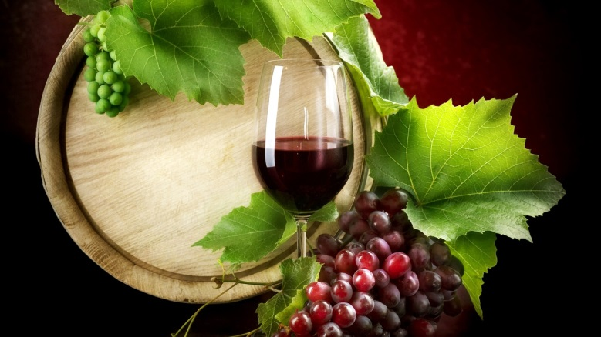
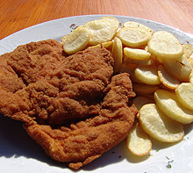
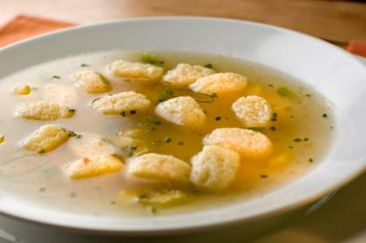
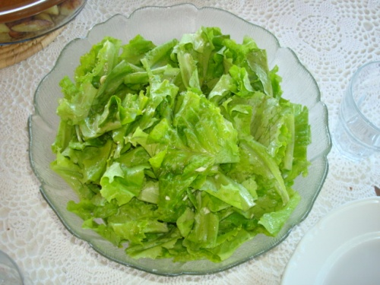
Traditional Slovenian lunch
Through the week we eat lunch when we come back from school or work, around 2 or 3 in the afternoon, maybe even later. But on Saturdays and Sundays we eat lunch earlier (around 12 or 1 o‘clock in the afternoon)
Typical Sunday lunch is beef soup with dumplings, fried chicken, roast or baked potatoes and green salad.
If we are thirsty, we usually drink wine or beer or non-alcoholic drinks, such as fruit juices and sodas.

Slide 6
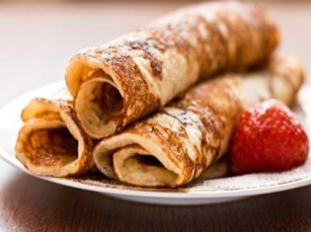
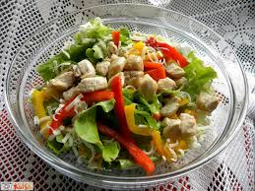
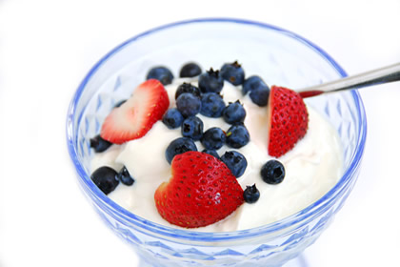
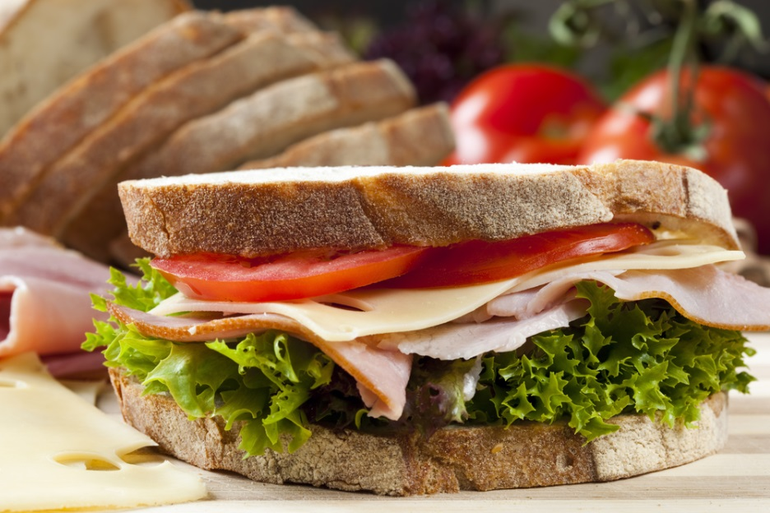
Traditional Slovenian dinner
We don‘t have typical foods for dinner. We usualy eat whatever we like. But dinner is a smaller meal than lunch.
For example: sandwich with salami and cheese, pancakes with jam, salad with chicken, yoghurt or leftovers from lunch.

Slide 7
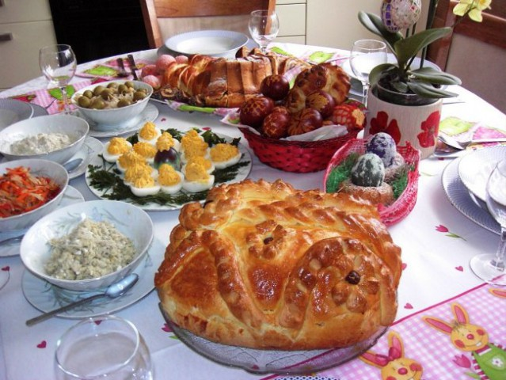
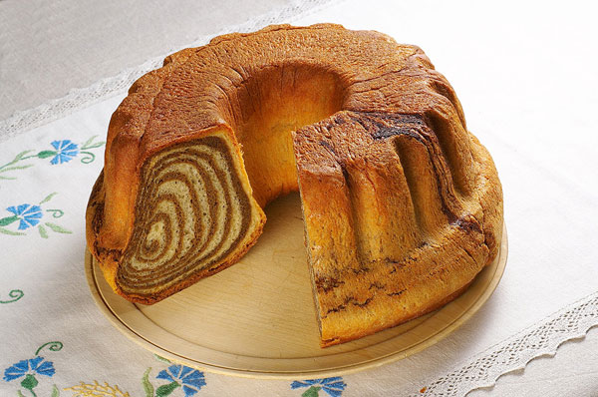
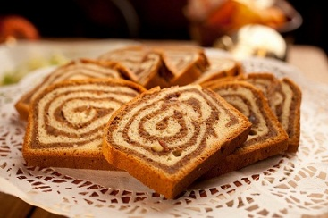
SOME TRADITIONAL SLOVENIAN FOODS:
Wallnut roll (potica)
Wallnut roll is a Slovenian traditional pastry similar to a strudel, with one or more fillings.
Usually we eat wallnut roll for Christmas and Easter and for other holidays.
Easter breakfast

Slide 8
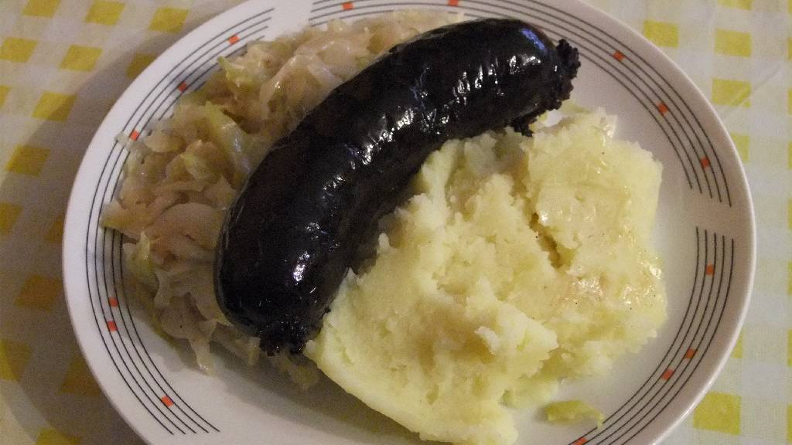
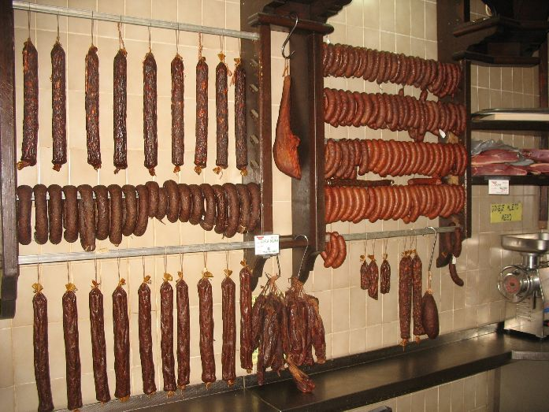
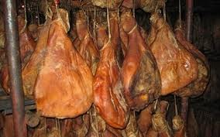
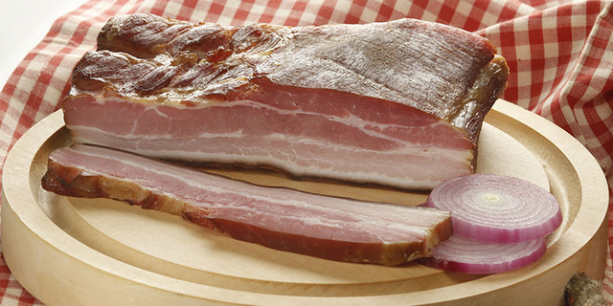
Blood sausage (krvavica)
This is a type of sausage made by cooking blood or dried blood until it‘s thick enough to harden when cooled.
They make it at pig slaughter day
We eat it with potatoes and sauerkraut
Pig slaughter day (koline)
is a widespread practice that involves pig slaughtering, processing and butchery of pig meat, and is observed by rural families, usually in late autumn. It can last three days.
They produce ham (šunka), bacon (slanina), the sausages (klobasica)

Slide 9
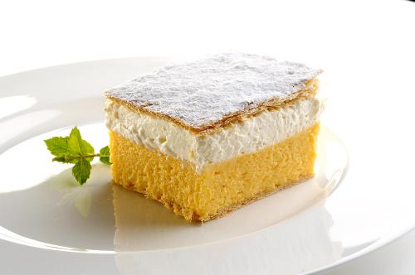
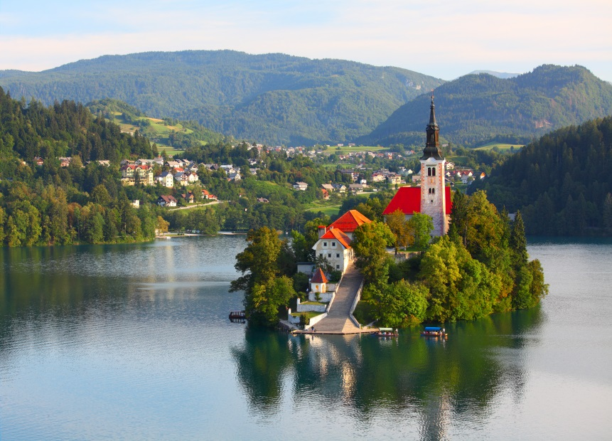
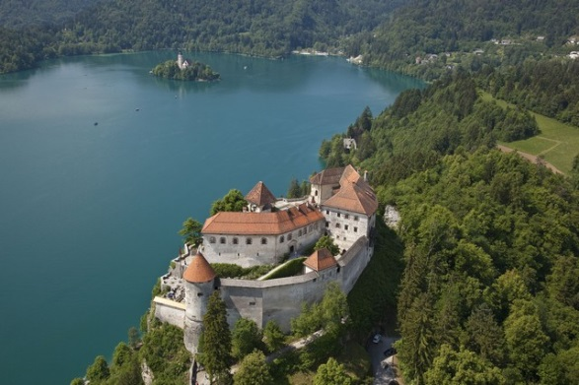
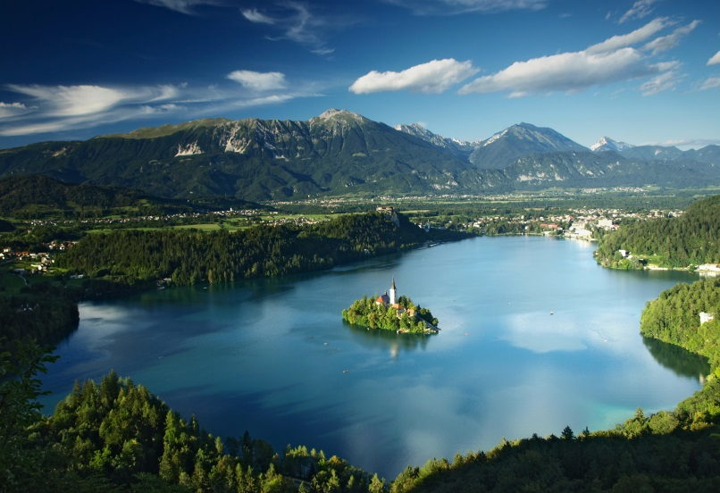
Bled cream cake(Blejska kremna rezina)
It‘s a traditional Slovenian dessert from the town Bled. Bled is an Alpine tourist destination in northwestern Slovenia.
Dessert consists of puff pastry on the top and bottom, in the middle there is whipped and custard cream.
The name of the dessert means simply "cream slice".
Bled

Slide 10
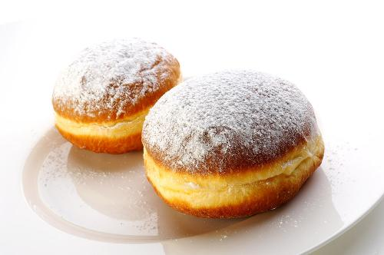
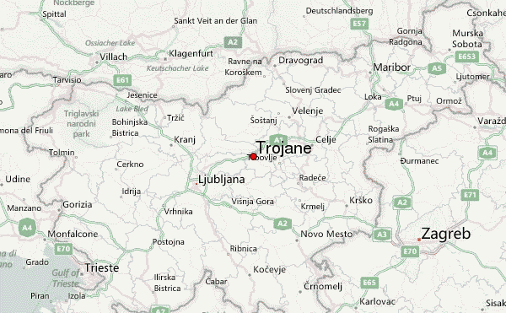
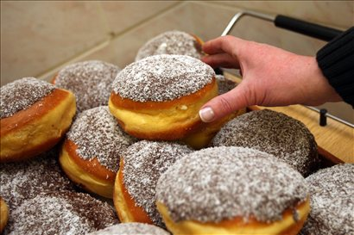
Trojane doughnuts (Trojanski krofi)
Trojane is a town in the center of Slovenia, right next to the highway.
Their doughnuts are really big and tasty.
They produce and sell between 2000 and 5000 doughnuts every day.
The Trojane doughnut is filled with marmalade. In the last few years they have also had doughnuts filled with vanilla cream, covered with chocolate and coconut flour.

Slide 11
SOURCES:
http://www.slovenia.info/en/en/Dishes-and-Recipes.htm?recepti=0&lng=2
http://www.mydestination.com/slovenia/usefulinfo/6175678/traditional-food-and-drinks
http://www.foodbycountry.com/Kazakhstan-to-South-Africa/Slovenia.html
http://en.wikipedia.org/wiki/Pig_slaughter
http://www.gp-trojane.si/ponudba_en.php#krof
https://www.google.si/search?q=slovenian+countryside&espv=2&biw=1680&bih=906&source=lnms&tbm=isch&sa=X&ei=d8C0VMGiLoW2ygPWl4K4DQ&ved=0CAYQ_AUoAQ#imgdii=_
http://www.e-slovenie.com/1141-food-in-slovenia-what-and-where-to-eat/

